Slide 1
MIS3690 Web Technologies
Babson College
TOIM Division
Fall 2015

Slide 2
Git Basics
Source: Mateusz Gałażyn

Slide 3
Outline
What is git? Why do you need it?
Repository structure
Basic workflow
Exercises!
Branches
Exercises!
Basic merging
Exercises!
Remotes
Exercises!
Graphical User Interface

Slide 4
What is Git?
An open source distributed version control system (VCS).

Slide 5
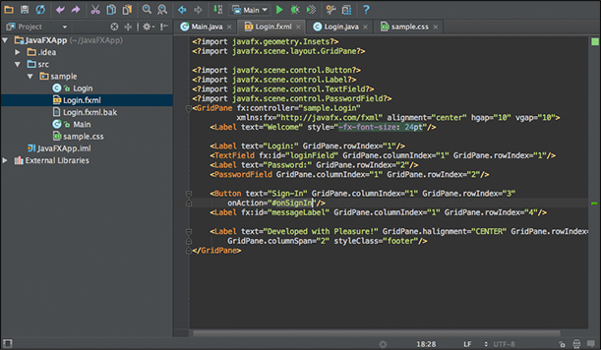
Why do you need a VCS?
Imagine a situation, when you’re writing your code...
... and suddenly after deployment on a production ...

Slide 6
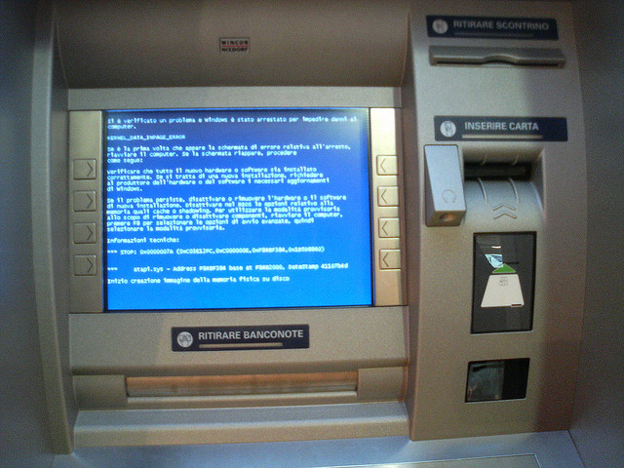
Why do you need a VCS?
Only working backup can save your life now
Notes:
Blue screen of death. At this point you need to downgrade your work to the latest working version ASAP and only working backup can save your life now. But how to deal with the backups?

Slide 7
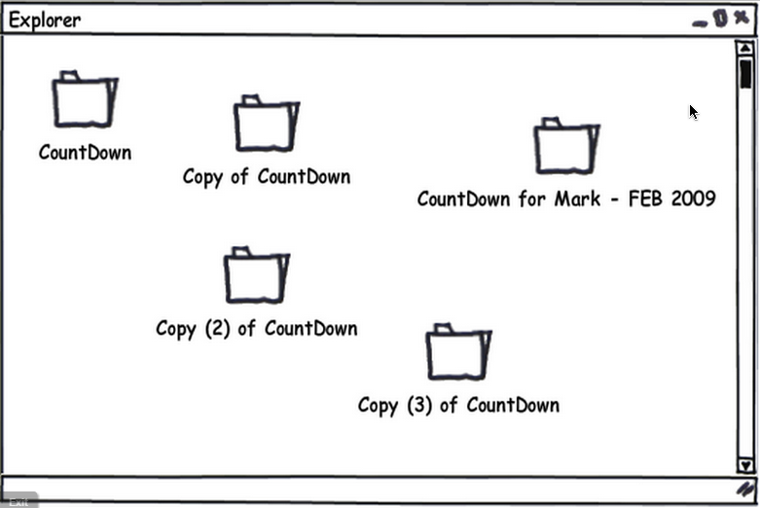
Why do you need a VCS?
You can store your backups in separate folders...
... but it’s not convenient
Notes:
... browsing a large number of folders manually is not efficient

Slide 8

What is Git?
Version Control System will do it for you!
A good VSC has to:
Prevent data loss
Provide history of who did what
Allow commit messages
Ease the creation of diffs / patches
Be fast and scalable

Slide 9
Why Git?
Git is distributed – (almost) everything is local – you can work offline and have backups on your local machine
Git is fast – again, most of your work is local, and network interactions are compressed and minimal
Notes:
Git is distributed – almost all of your work is saved in your local repository, so you do not waste time on downloading backups and you can work offline
Git is fast – because the backups are in your local repository and network utilization is as little as it is possible

Slide 10
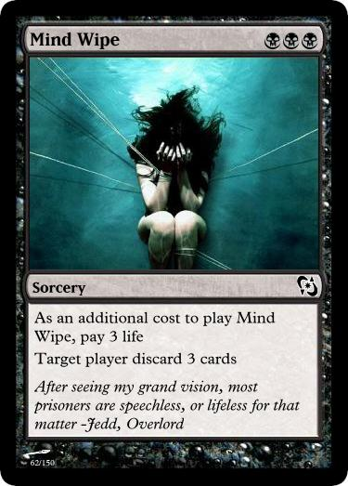
Before we get into Git...
As you learn Git, try to clear your mind of the things you may know about other VCSs.
Git stores and thinks about information much differently than other systems and doing so will help you avoid subtle confusion when using the tool.
Notes:
But before we get into Git, try to clear your mind from other things you may know about other VCSs.

Slide 11
Repository structure
A repository is a collection of commits
A commit is a snapshot of your working tree at some point of time
A working tree is a directory (and sub-directories) which has repository associated with it

Slide 12
Basic Git workflow
At the beginning of work with Git we are creating empty repository (or cloning an existing one)
Repository

Slide 13
Basic Git workflow
During our work, we are modyfing file structure inside a Working Tree
Repository
Working
Tree

Slide 14
Basic Git workflow
Changes from the working tree are not registered in the repository directly. Instead, they are registered in the Index. The other name for it is a „staging area”.
Repository
Working
Tree
Changes to the working tree are registered in the index using
Index
git add
“staging area”
Notes:
Unlike other, similar tools you may have used, Git does not commit changes directly from the working tree into the repository. Instead, changes are first registered in something called the index. think of it as a way of “confirming” your changes, one by one, before doing a commit (which records all your approved changes at once). Some find it helpful to call it instead as the “staging area”, instead of the index.

Slide 15
Basic Git workflow
Once the index contains everything you want to commit, you record the changes in the repository
Repository
Working
Tree
Changes are commited to the repository from the state of the index using
Changes to the working tree are registered in the index using
Index
git add
git commit
“staging area”

Slide 16
Basic Git workflow
Earlier states of the working tree may be checked out from the repository at any time using
Repository
Working
Tree
git checkout
Changes are commited to the repository from the state of the index using
Changes to the working tree are registered in the index using
Index
git add
git commit
“staging area”
Notes:
If you would like to revert the changes in the working tree to a particular commit, you can do it using git checkout.
This is the basic git workflow. It goes like this preety much every time.
To recap, at first you are creating new repository, or cloning existing one, making changes, adding changes to index, and committing changes to the repository.
Now it is the time for some practice!

Slide 17
Exercise #0
Install Git:
Go to git-scm.com
Download installer and execute it
(IMPORTANT) In the Adjusting your PATH environment select first option ”Use Git from Git Bash only”
For the rest of options you can leave default choices

Slide 18
Exercise #1
TODO:
Create an empty repository
Make changes in the file system and add to index
Commit
Make changes in the file system
Reset to the clean state
Make changes in the file system and add to the index
Commit
Diff between commits
Checkout the first commit

Slide 19
Exercise #1
Before we start we need to configure Git
git config --global user.name "your-name"
git config --global user.email "mail@youremail.com"
Notes:
Use up arrow to get what was before

Slide 20
Exercise #1
Create an empty repository locally
Make changes in the file system and add them to index
Commit
git init .
echo ”first changes” > file1.txt
echo ”a very important message” > file2.txt
git add .
dot adds whole directory at once
git commit –m ”my first commit”
commit message is obligatory

Slide 21
Exercise #1
Make changes in the file system
Reset only non-staged changes to the clean state (latest commit)
You can use instead of dot, a path to a specific file.
To reset working tree and index:
echo ”foo foo bar bar” > file2.txt
git status
git diff
git checkout .
git reset --hard HEAD
a name for the the latest checked out commit
Notes:
Checkout is like undo -ing

Slide 22
Exercise #1
Diff between commits
Checkout the first commit
Current repository structure:
git log --oneline
git diff 933734d f618b84
Your hash ids will be different
git checkout 933734d
HEAD
my first commit
my second commit

Slide 23
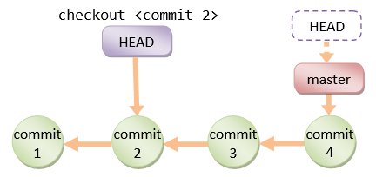
Detached HEAD???
So what happens when you checkout a commit from a past, and make another commit?

Slide 24
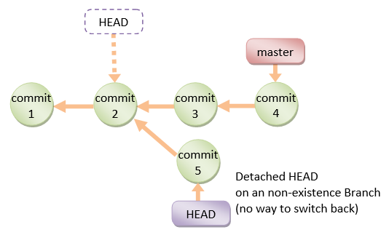
Detached HEAD???
You are ending in the Detached HEAD state.
After some time such commits in the detached head can be pruned by the garbage collector and your work will be lost.

Slide 25

Detached HEAD???
This can be fixed, requires merging (sometimes a lot).
Golden rule: Always work on the latest commits.
Avoid detached HEADS. Use branches instead.

Slide 26
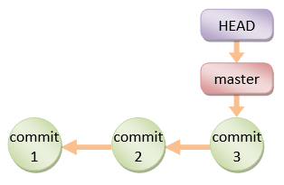
Branches
A branch (reference, ref) is also another name of a commit. It is the name for the last commit in the line. By default, git creates master branch:

Slide 27
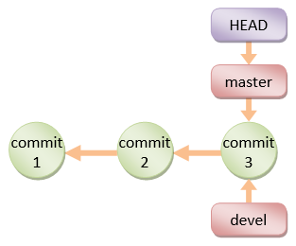
Branches
At each point you can easily create your new branch using following command:
Now we have two branches (pointing for the same commit):
git branch devel

Slide 28
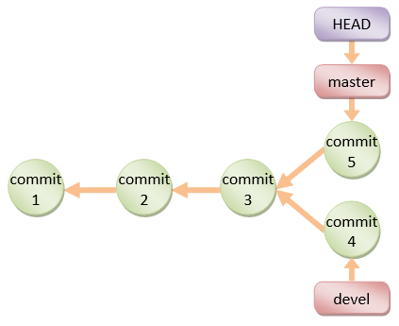
Branches
Using branches you can for example store working releases of an application in a master branch and development line in devel one:
... let’s try them out!

Slide 29
Exercise #2
TODO:
Create new branch
Commit changes
Create another branch
Diff between branches
Delete branch

Slide 30
Exercise #2
Create new branch
Commit changes
Current repository structure:
git checkout master
git branch branch-1
git checkout branch-1
echo ”b1” >> file1.txt
echo ”foo bar bar” > file2.txt
git add .
git commit -m ”b1”
master
my first commit
my second commit
b1
branch-1
HEAD

Slide 31
Exercise #2
Create another branch
Current repository structure:
git branch branch-2
eit checkout branch-2
echo ”b2” >> file1.txt
git add .
git commit –m ”b2”
HEAD
master
branch-2
my first commit
my second commit
b1
b2
branch-1

Slide 32
Exercise #2
Diff between branches
Delete branch
Current repository structure:
git diff branch-1 branch-2
git checkout master
git branch -d branch-2
HEAD
master
my first commit
my second commit
b1
branch-1

Slide 33
Basic merging
What to do when we want to join few different branches?
to the rescue!
Most common merge types:
Fast-forward merge
3-way merge
Rebase
git merge

Slide 34
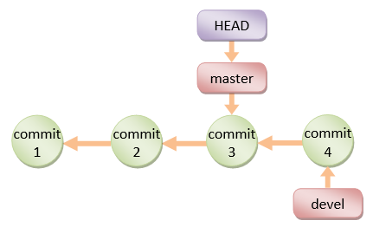
Fast-Forward merge
Let’s assume we have the following repository structure:
We would like to merge
devel into master

Slide 35
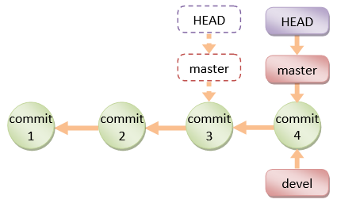
Fast-Forward merge
Let’s assume we have the following repository structure:
We would like to merge
devel into master
Fast forward merge moves master pointer forward to the commit 4 and no new commit is created

Slide 36
3-way merge
Let’s assume we have the following repository structure:
We would like to merge
devel into master

Slide 37
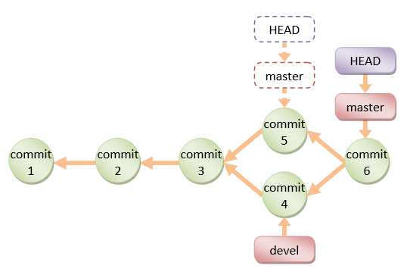
3-way merge
Let’s assume we have the following repository structure:
We would like to merge
devel into master
With Git you can merge files containing conflicts (changed in commits 5 & 6), manually decide which changes should be applied and create merge commit (commit 6).

Slide 38
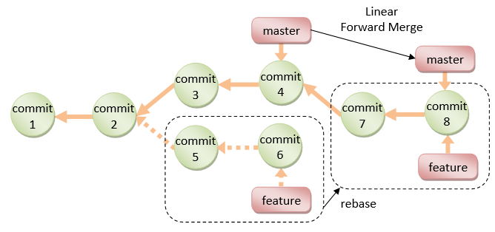
Rebase
Let’s assume we have the following repository structure and we would like to merge feature into master:
With rebase you can apply commits from feature branch on top of master and preserve linear structure of repository.

Slide 39
Exercise #3
TODO:
Make a fast-forward merge
Undo ff-merge
Make commit on master
Make 3-way merge
Undo merge commit
Make rebase

Slide 40
Exercise #3
Make a fast-forward merge
Before After
git checkout master
git merge branch-1
master
master
my first commit
my second commit
b1
my first commit
my second commit
b1
branch-1
branch-1
HEAD
HEAD

Slide 41
Exercise #3
Undo fast-forward merge
It moves the HEAD pointer back by 1 commit and resets working tree
Make commit on master
git reset --hard HEAD~1
echo ”a very unimportant message” > file2.txt
git add file2.txt
git commit -m ”m1”
m1
master
HEAD
my first commit
my second commit
b1
branch-1

Slide 42
Exercise #3
Make 3-way merge
We have merge confilct (contents of file2.txt):
After correcting file2.txt, execute following commands:
git checkout master
git merge branch-1
git status
<<<<<<< HEAD
a very unimportant message
=======
foo bar bar
>>>>>>> branch-1
git add file2.txt
git commit -m ”merge commit”

Slide 43
Exercise #3
Current repository structure:
HEAD
master
m1
my first commit
my second commit
merge commit
b1
branch-1

Slide 44
Exercise #3
Undo 3-way merge
Repository structure after reset:
git reset --hard HEAD~1
m1
master
HEAD
my first commit
my second commit
b1
branch-1

Slide 45
Exercise #3
Make git rebase
We have merge confilct (contents of file2.txt):
After correcting file2.txt, execute following commands:
git checkout branch-1
git rebase master
<<<<<<< HEAD
a very unimportant message
=======
foo bar bar
>>>>>>> branch-1
git add file2.txt
git rebase --continue
git checkout master
git merge branch-1

Slide 46
Exercise #3
Repository structure after rebase:
HEAD
master
my first commit
my second commit
m1
b1
branch-1

Slide 47
Remote repositories
Git remote repositories can be accessed via almost every protocol: SSH, HTTP(S), FTP, Local, Git...
You can clone remote repository using
You can publish your changes using
You can pull changes on remote to your local repo using

Slide 48
Exercise #4
TODO:
Create new empty local repository
Copy local repository to a remote server
Add remote to your repository
Push changes to a remote repository
Clone remote repository

Slide 49
Exercise #4
Create new empty local repository
Create new directory with your last name and go there with git bash
Copy local repository to a remote server
Copy this directory to \\git-exercise\1
Add remote to your repository
Navigate using git bash to your repository from previous exercises
Push changes to a remote repository
git init --bare
git remote add origin file:////git-exercise/1/lastname
git push --set-upstream origin master

Slide 50
Exercise #4
From now you can push commited changes to the remote using only:
Clone remote repository
Using git bash go to directory one level higher
git push
git clone file:////git-exercise/1/someoneslastname

Slide 51
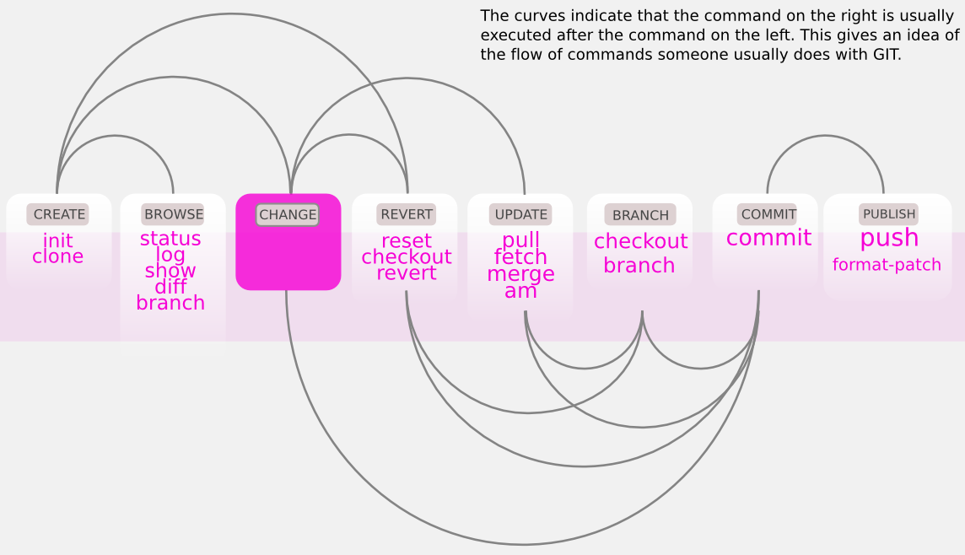
Recap - command sequence

Slide 52

Don’t be scared of Git! :)
Questions?
( you can always ask me directly or
send an e-mail to: zli@babson.edu )
git push –f overwrites the remote branch with the state of the branch you are pushing, so using it you can accidentally overwrite commits you want to keep

